Slide 1

Notes:
Statistics is about articulating the patterns we see in the data using numbers. Now it is not that simple and there is a number a caveats to each approach but this is what our drop-in sessions are about.
We provide support by discussing and developing statistical approaches to your research and link you with the correct resources and experts needed to achieve these approaches.

Slide 2


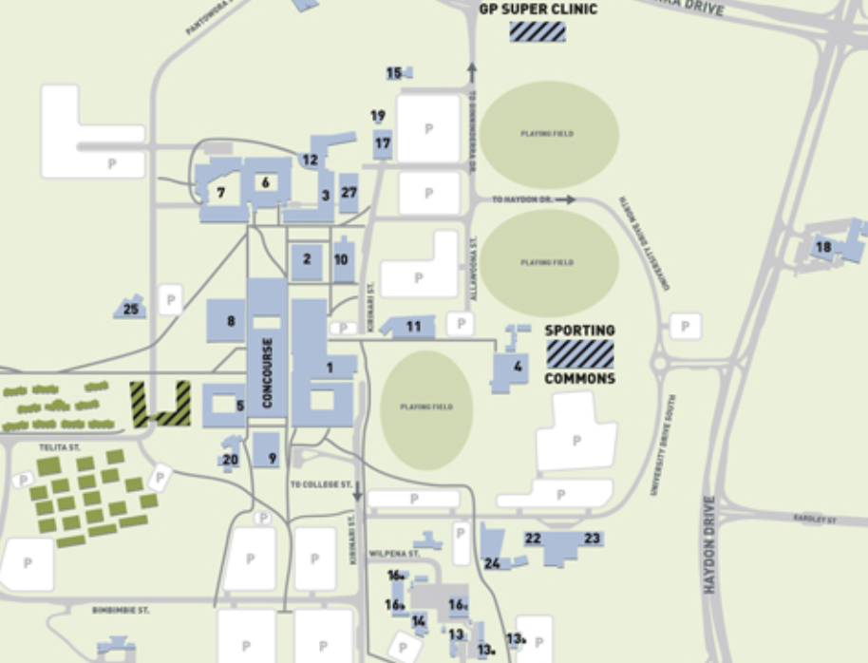
Statistical support network
Statistical support 2018
Level 3
Drop-in sessions:
1pm-3pm
Every Thursday
Room 9C18
Office (3C3)
Monday - Friday
9am - 5pm
Level 3
Researcher Development
E: ResearcherDevelopment@canberra.edu.au
Statistical Advisor:
E: Anthony.Davidson@canberra.edu.au

Slide 3
Statistical support network
Statistical support 2018
Drop-in sessions:
1pm-3pm
Every Thursday
Room 9C18
Level 3
Researcher Development
E: ResearcherDevelopment@canberra.edu.au
Statistical Advisor:
E: Anthony.Davidson@canberra.edu.au

Slide 4
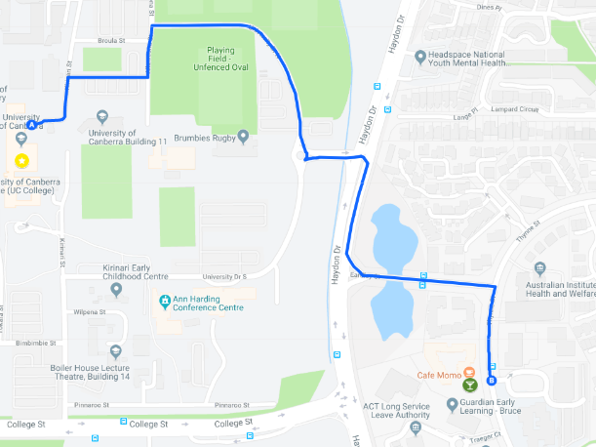
A new trial!!
Coding sessions:
9am-12pm
Every Wednesday
Café Momo
5min walk off campus
Researcher Development
E: ResearcherDevelopment@canberra.edu.au
Statistical Advisors:
E: statistics.network@canberra.edu.au

Slide 5
Statistical support network
Statistical support
2018
Level 3
Drop-in sessions:
1pm-3pm
Every Thursday
Room 9C18
Coding sessions:
9am-12pm
Every Wednesday
Café Momo
5min walk off campus
Researcher Development
E: ResearcherDevelopment@canberra.edu.au
Statistical Advisors:
E: statistics.network@canberra.edu.au

